Slide 1
Quick start for package R2DOCX

Slide 2
Overview
The R2DOCX package lets you output text, tables, and graphs in Microsoft Word docx format.
An existing Microsoft Word docx file can be used as a document template. A replacement function lets you replace keywords in the template (e.g. AUTHOR, TITLE, etc.)
User can add table of contents and customizes table of contents (e.g. table of produced graphics)
Formatting functions are available to customize tables and texts.

Slide 3
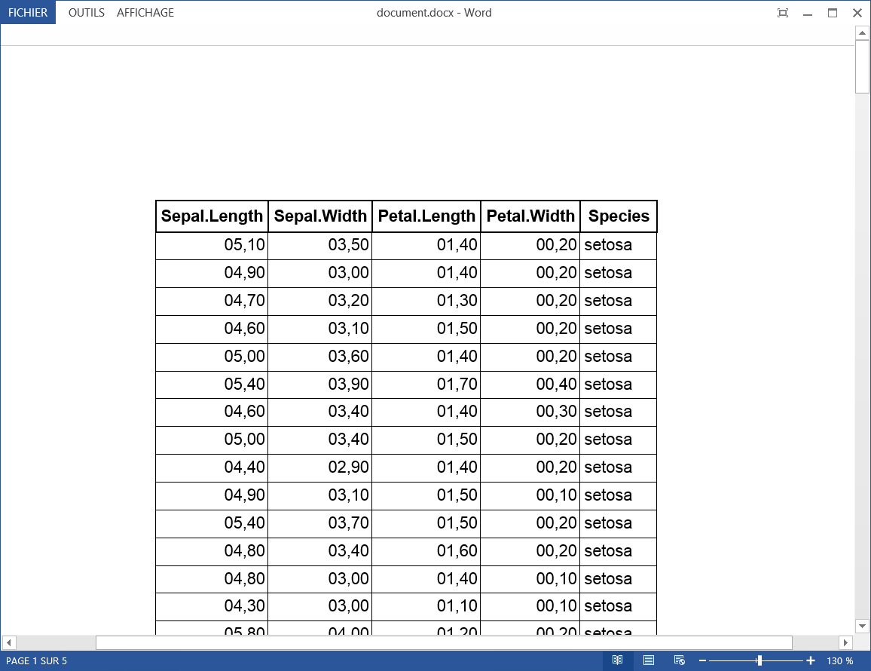
Simple example
require(R2DOCX)
doc=new("Docx",title="My example")
doc=addTable(doc,iris)
writeDoc(doc,"document.docx")

Slide 4
Adding plots

Slide 5
addPlot function

